Slide 1
V-Games
A ONLINE VIDEO GAME SHOPPING MALL
YIPENG HONG
ZHUOHANG FENG
XINYUN CHEN
LEI LIU

Slide 2
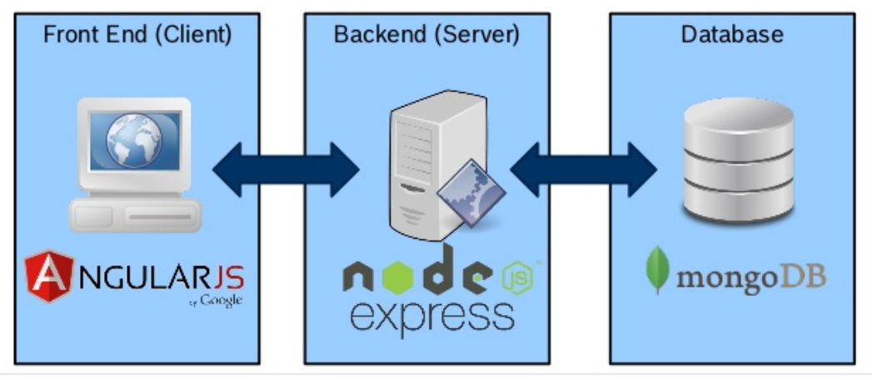
The Architecture of the Website

Slide 3
INTRODUCTION
An Video Game Online Shopping Website that provides video game information on where users can:
  Search specific game
  Get game details
  Add what items users like into Wishlist
  Choose whatever you want and Checkout
  Editing your profile including your password

Slide 4
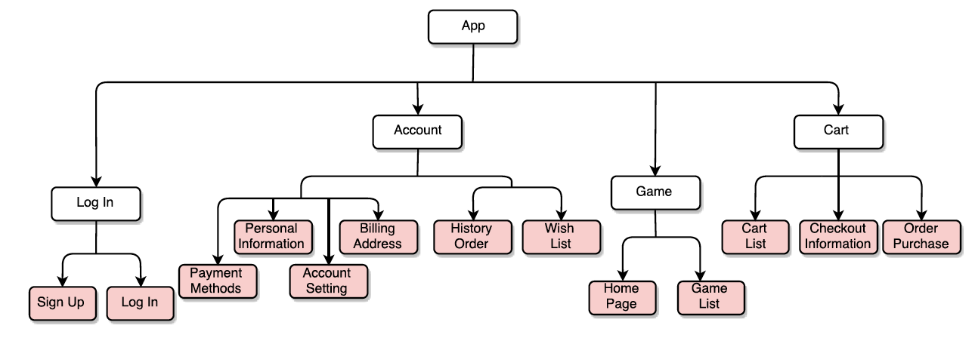
The Structure of V-Game

Slide 5
Home page–User can get the latest and featured game videos and images
Features
  Feature 1 – as a hub of other functions like game list, cart and account information
  Feature 2 – show list of video games information including some details and latest released video
  Feature 3 – click Readmore and Image linked into game detail page

Slide 6
Account Systems–User can login and logout, view history and change profiles
Features
  Feature 1 – Sign up a new account.
  Feature 2 –Login&out a account from the website.
  Feature 3 – View personal ordered history
  Feature 4 – Enable to edit user information including contact information, payment method, billing address and account settings.

Slide 7
GameList–User can look through games and find specific one by search function
Features
  Feature 1 – View all the game in the list.
  Feature 2 – Sort this list by ID, Title and Score.
  Feature 3 – Filter specific items by different consoles.
  Feature 4 – Search specific one by keywords.
  Feature 5 – click specific game and view that detail.

Slide 8
GameDetails–User can get all of the information about the game.
Features
  Feature 1 – View game details in one page.
  Feature 2 – Click “Add To Cart” to add item into his own cart.
  Feature 3 – Click favorite icon to add item into his wishlist.

Slide 9
WishList–User can store some items they like and can add these items into cart.
Features
  Feature 1 – QuickView game details in this wishlist.
  Feature 2 – Click “Add To Cart” to add item into his own cart.
  Feature 3 – View all games in the wishlist.

Slide 10
Cart–User can view which items they prepare to buy.
Features
  Feature 1 – QuickView added game in this cart.
  Feature 2 – Click “View Cart” to final decision page.
  Feature 3 – Change the quantity of items by “up&down” button or input number directly.
  Feature 4 – Click “Clear cart” to empty the shopping cart.
  Feature 5 – Click “Checkout” to check out all of your items in cart.

Slide 11
Check-out – User can submit user’s payment details and Billing information.
Features
  Feature 1 – Submit information of your card for paying.
  Feature 2 – Submit billing information for paying.
  Feature 3 – Click “Countinue” button to reception page.

Slide 12
Receipt – User can view user’s purchased items and payment information.
Features
  Feature 1 – View information of purchased items, Receipt ID and of receipt creation time.
  Feature 2 – Click ”Return Cart” button, users can return to cart page and rethink their decisions.
  Feature 3 – Click “Purchase” button to finalize purchase and then user will be navigated to view ordered history.

Slide 13
Timeline of V-Game project
11-14
11-17
11-23
11-30
12-6
12-11
Topic Chosen & Brainstorming
Requirements analysis
Functions Confirmations
Web Architecture established
Responsibility Assignment, Implements & Integration
On Time!

Slide 14
Project Dynamics -How did our team divide up the work?
YIPENG HONG:
  Database, Account Systems, Login Logout, Navigation Bar and Footer Design.
ZHUOHANG FENG:
  Home Page Design, Data Validation Setting
LEI LIU:
  Game List, Game Details Page Design and Searching Function Implements
XINYUN CHEN:
  Cart, Checkout, WishList Page and General UI Style Design

Slide 15
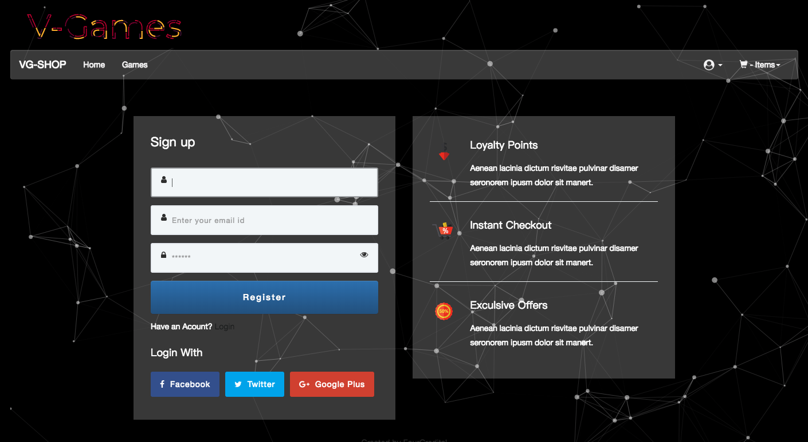
Sign up

Slide 16
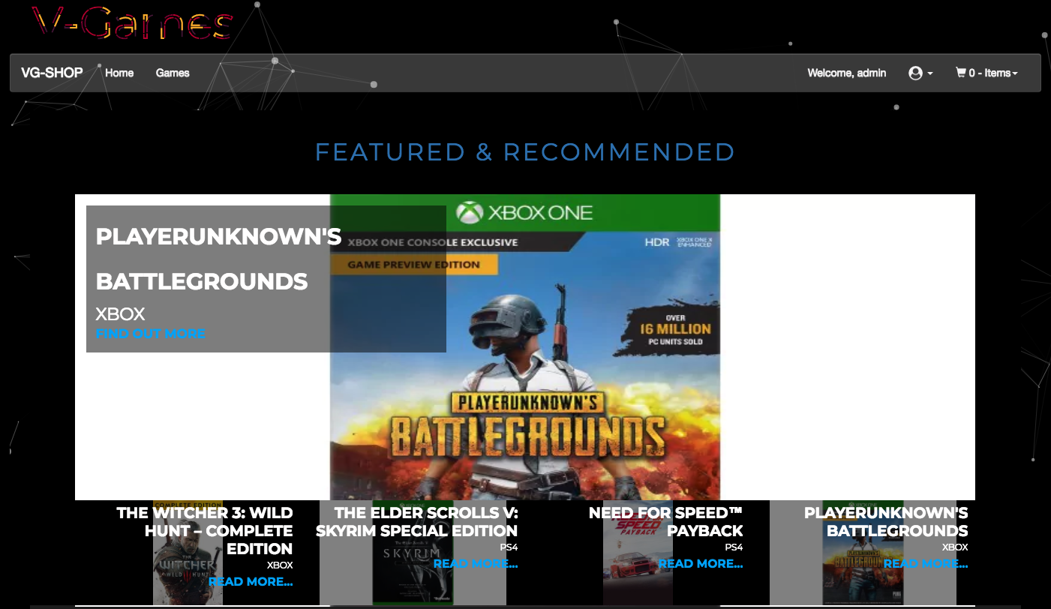
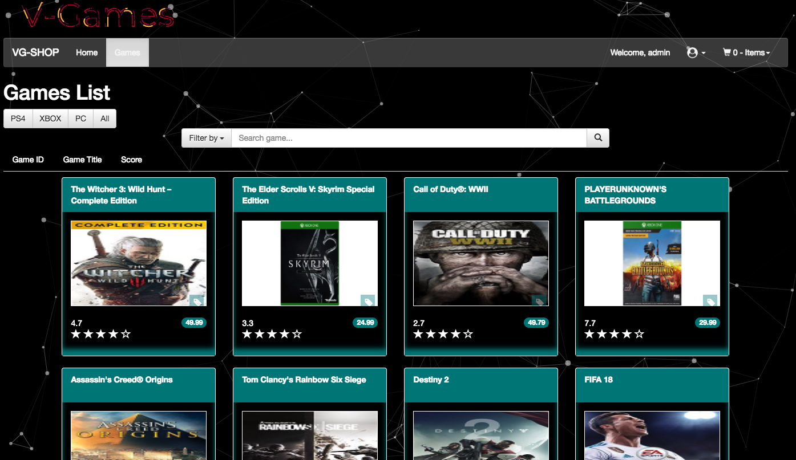
Pages

Slide 17
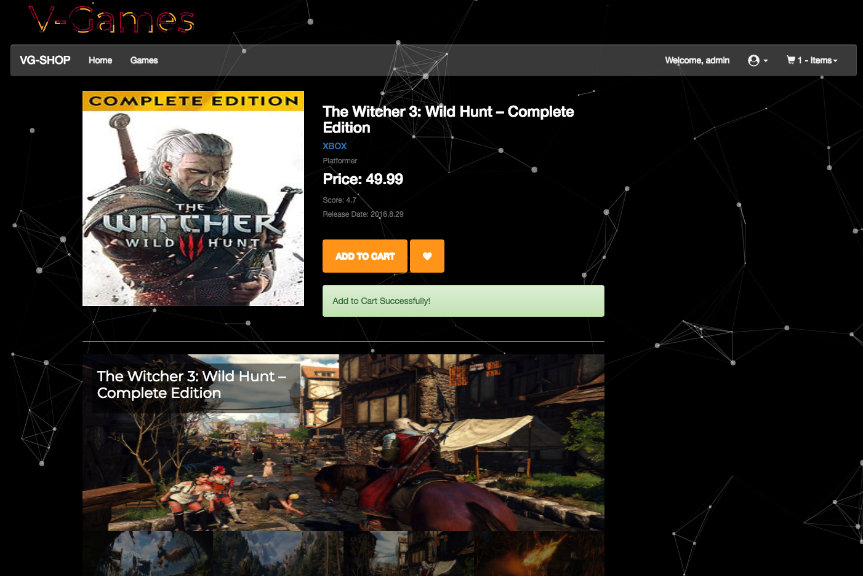
Shopping

Slide 18
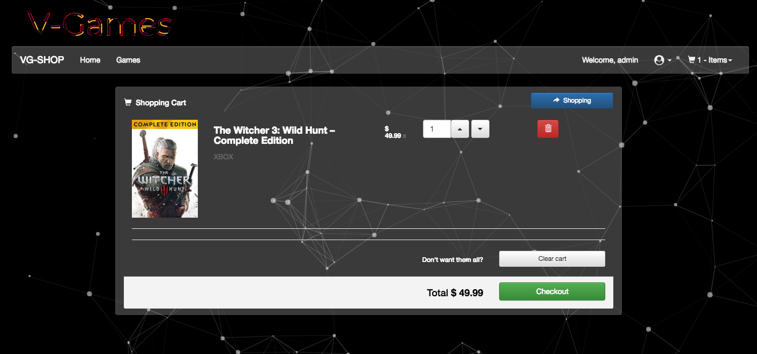
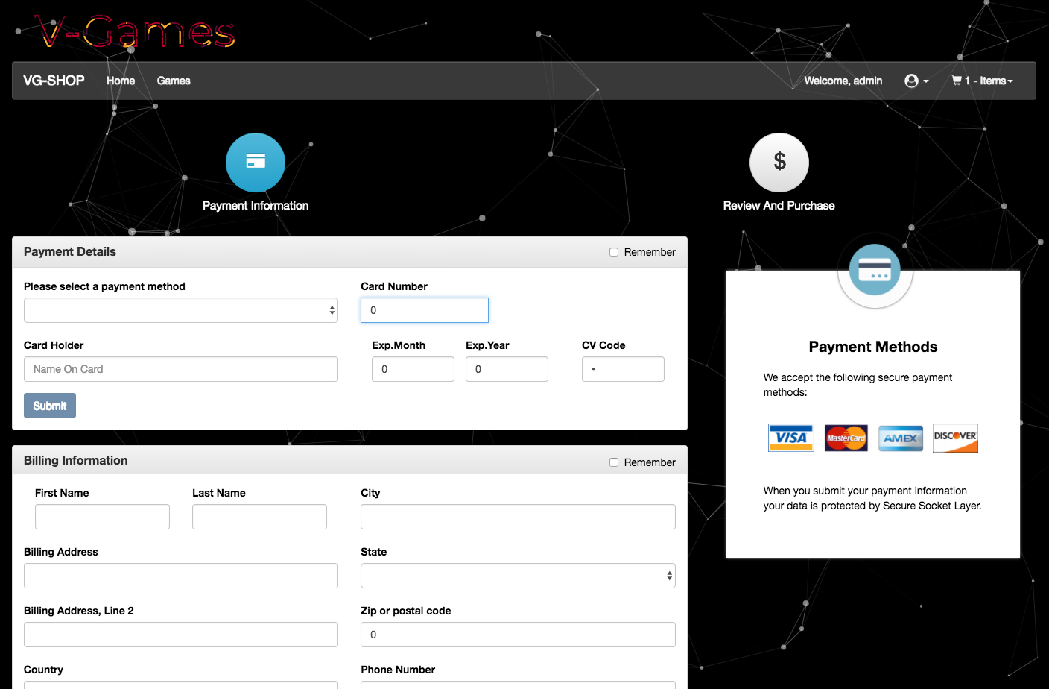
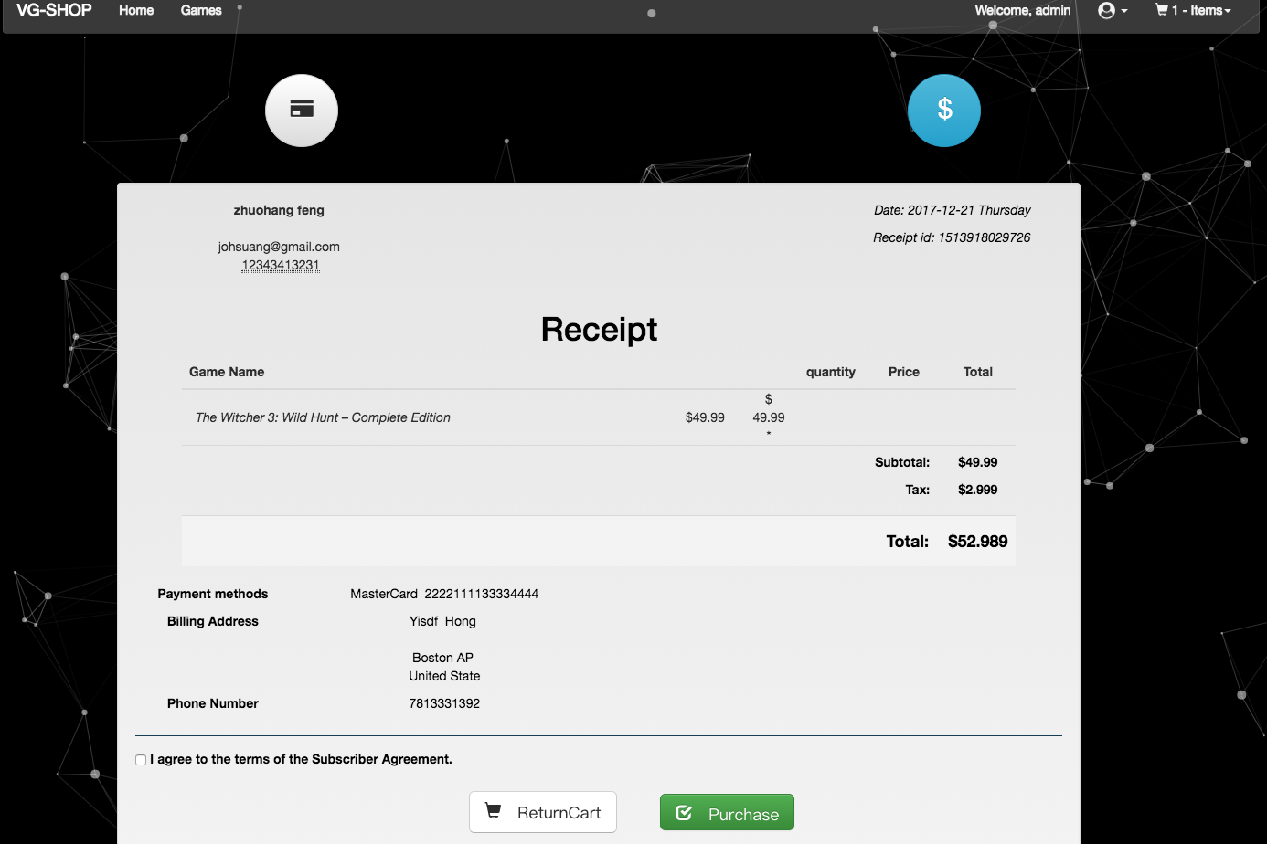
Check out

Slide 19
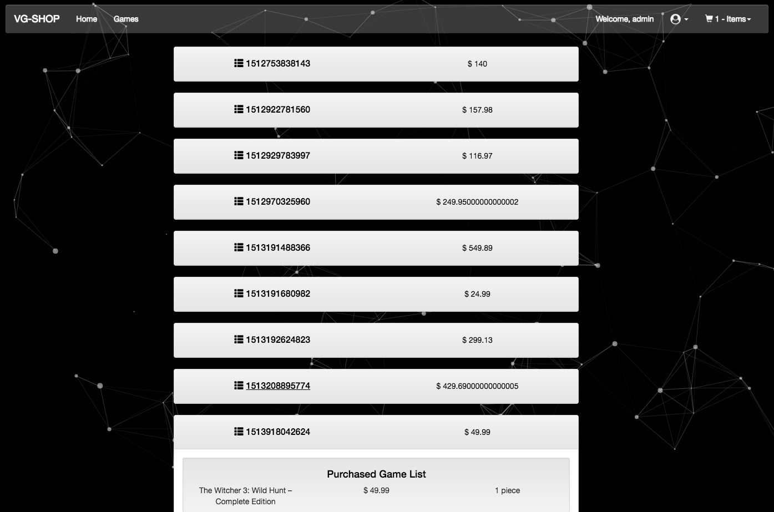
Shopping history

